Slide 1
Sevier Orogenic Belt in Nevada and Utah
Presented by Luke J Schranz
Richard Lee Armstrong, 1968

Slide 2
Cretaceous to early Miocene Unconformity
N

Slide 3
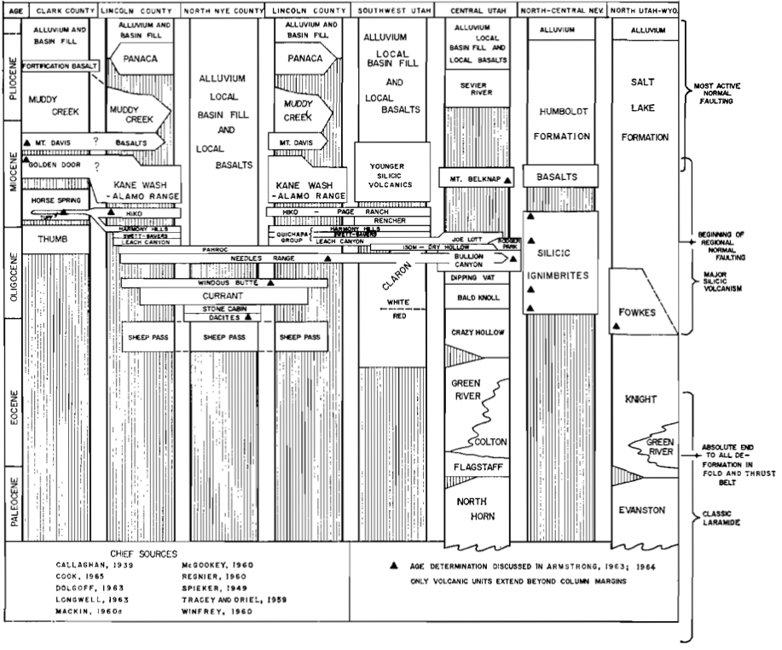

Slide 4
Pre-Tertiary data points
N

Slide 5
Pre-Tertiary paleogeographic reconstruction
N

Slide 6
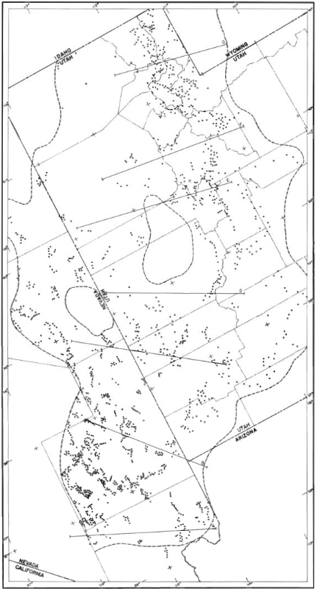
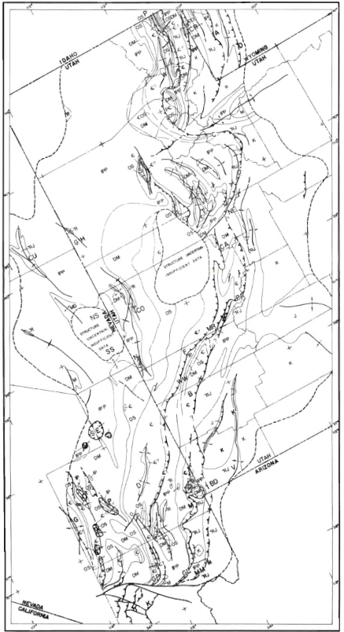
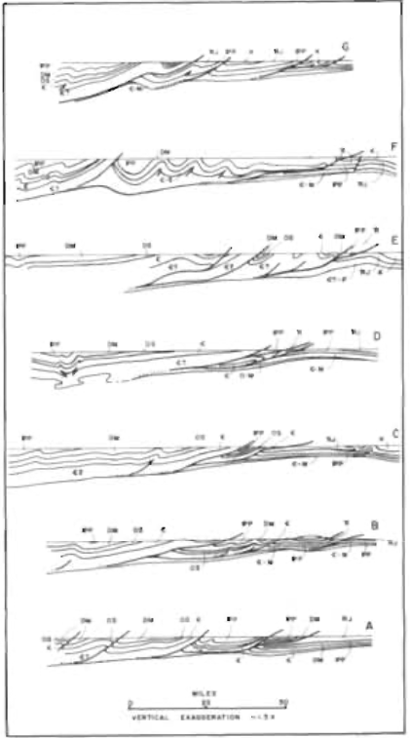

Slide 7
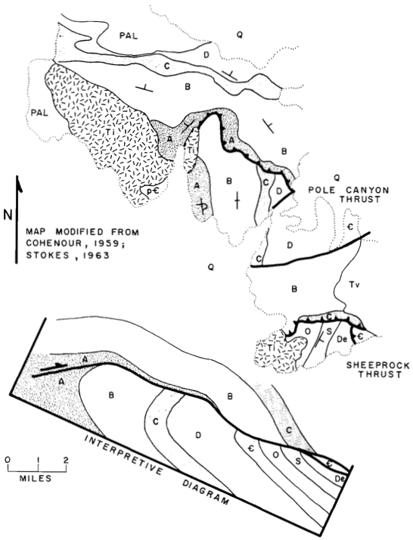
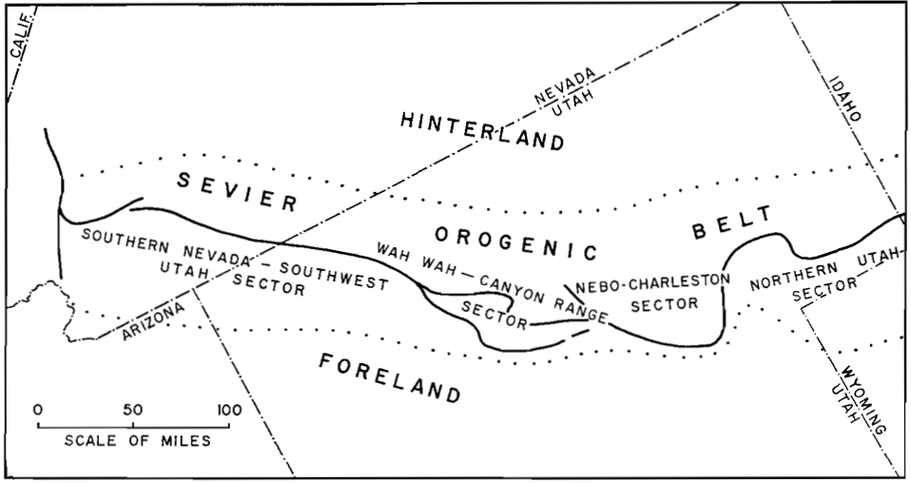

Slide 8
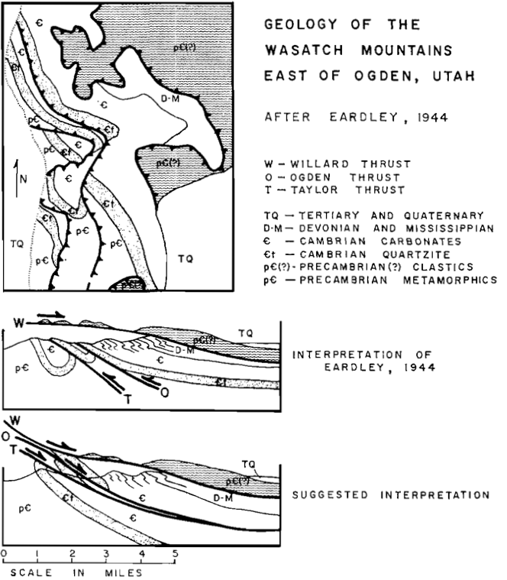

Slide 9
40 miles minimum of thrusting in Sevier belt
60 miles for a reasonable estimate

Slide 10
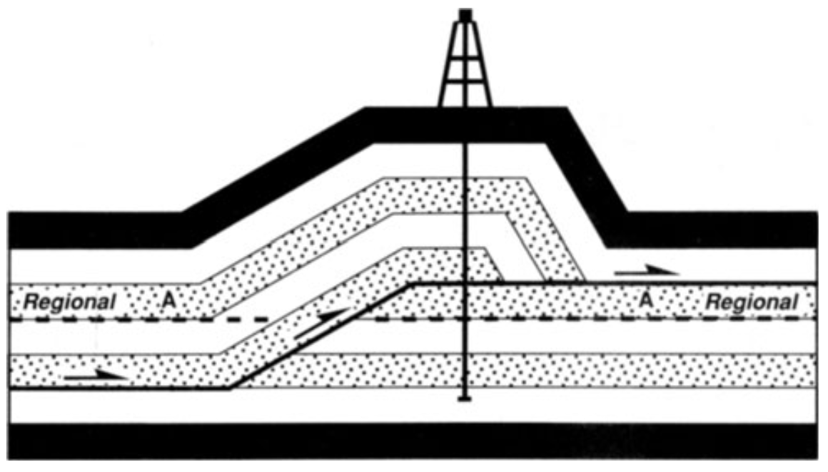
Style of deformation
30,000-40,000’ of strata behaved competently over their entire thickness (on larger thrusts)
Cambrian shales provide major weakness for thrust movement

Slide 11
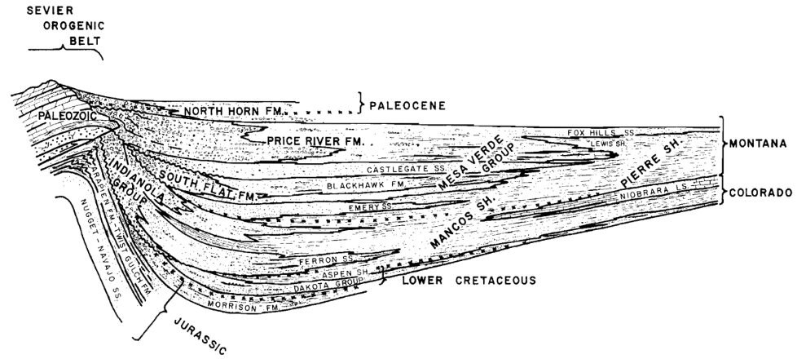
Cretaceous sedimentation as additional evidence
Wikipedia

Slide 12
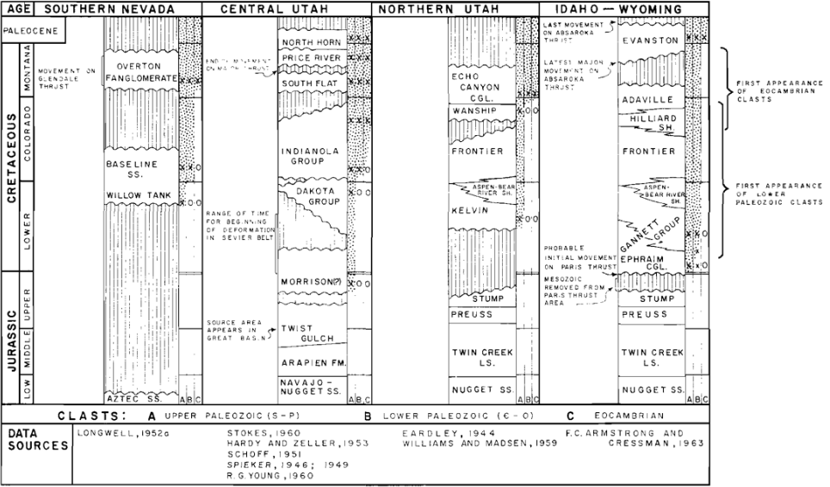

Slide 13
Summary
Late Jurassic through Cretaceous deformation
Youngest structures are to the east
Notable differences between Sevier and Laramide orogenies - these should not be lumped or confused

Slide 14
